Slide 1
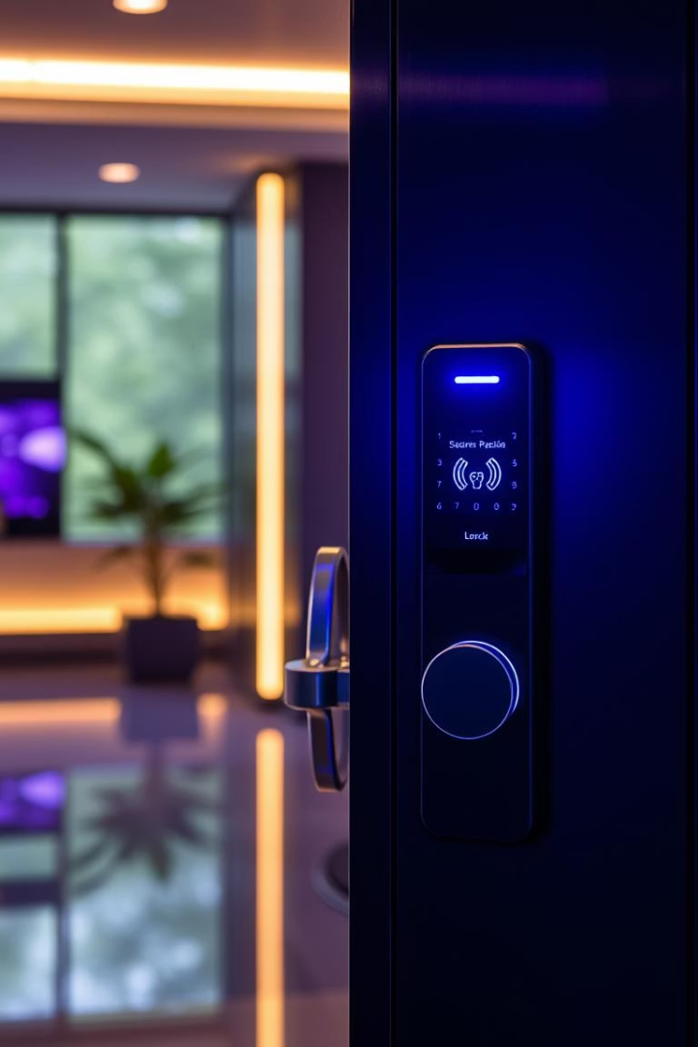
Face Recognition Lock: Securing Your World
Discover how face recognition locks enhance security and convenience. This presentation covers technology, benefits, and real-world applications.
tt
by Subba Reddy

Slide 2
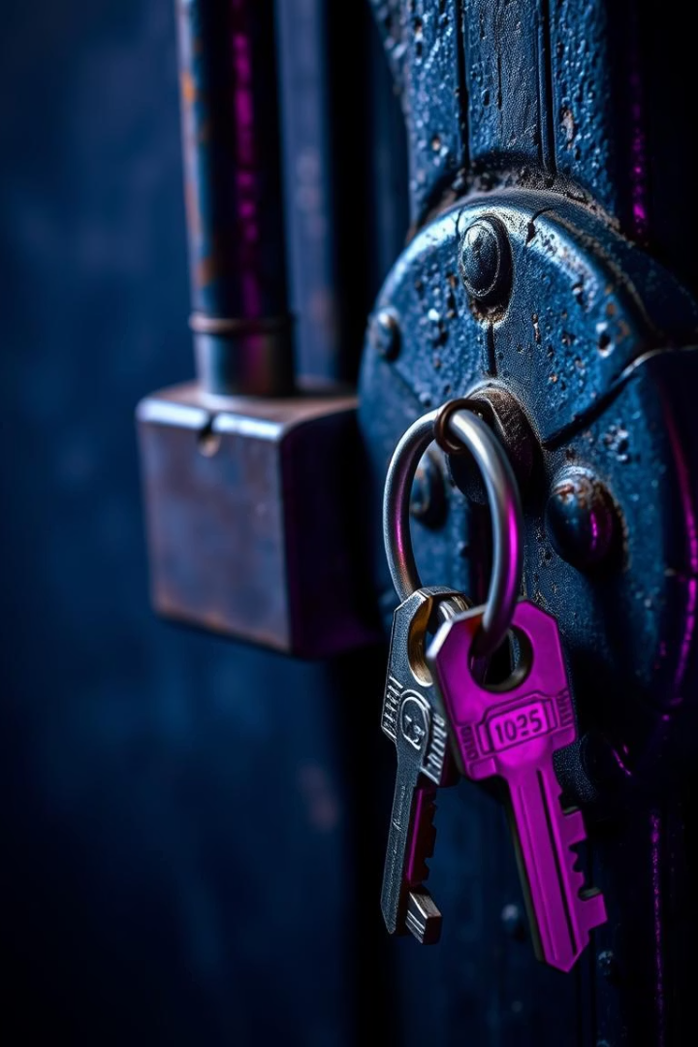
The Problem: Traditional Lock Vulnerabilities
Key Duplication Risks
Keys can be copied without permission, risking unauthorized access.
Lost or Stolen Keys
Lost keys compromise security, requiring lock replacement or rekeying.
Picking and Burglary
Traditional locks are susceptible to picking and forced entry.
Inconvenience
Managing multiple keys is cumbersome for homes and offices.

Slide 3

Introducing Face Recognition Technology
Biometric Authentication
Touchless Access
Uses unique facial features to identify authorized users instantly.
Eliminates the need for physical keys or cards.
High Accuracy
Fast and Convenient
Advanced algorithms minimize false accepts and rejects.
Unlock your door in seconds with simple face scan.

Slide 4
How Our Face Recognition Lock Works: A Deep Dive
Facial Capture
Recognition Engine
Access Control
Data Security
Camera scans face using infrared and RGB sensors for accuracy.
AI processes unique features and matches them against stored profiles.
Unlock signal is sent only upon valid identity confirmation.
Facial data is encrypted and stored locally to protect privacy.

Slide 5








Security Features: Beyond Face Recognition
Multi-factor Authentication
Anti-Spoofing Measures
Combine face recognition with PIN or fingerprint for extra security.
Liveness detection prevents access with photos or masks.
Temporary Access Codes
Remote Access Alerts
Grant limited-time entry for guests or service personnel.
Receive notifications and control lock status via smartphone.

Slide 6
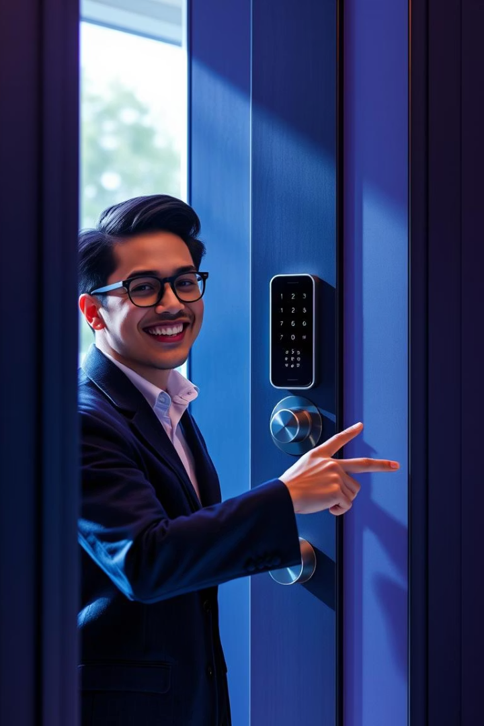
User Experience: Seamless and Intuitive
Easy Enrollment
Register faces quickly through a simple app interface.
Instant Unlock
Door unlocks within seconds after recognition, no waiting.
Multiple User Support
Store profiles for family, employees, or frequent visitors.
Maintenance Alerts
Get notified when batteries are low or device needs updates.

Slide 7
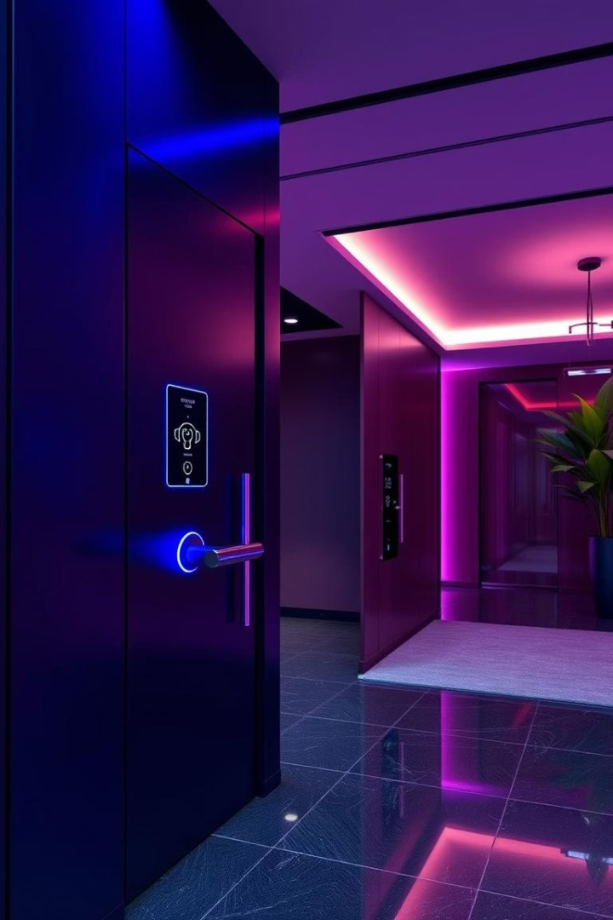




Applications: Home, Office, and Beyond
Residential Security
Workplace Access
Hospitality
Offer guests convenient, individual access without physical keys.
Protect your loved ones with keyless, easy access.
Manage employee entry securely and efficiently.
Industrial Use
Control access to sensitive areas with detailed logs.

Slide 8

The Future of Security: Continuous Innovation
1
AI Enhancements
Improving recognition speed and accuracy with machine learning.
2
Integration
Seamless connection with smart home and security systems.
3
Privacy Safeguards
Innovations to keep biometric data safe and user-controlled.
4
Expanded Use Cases
New industries adopting face recognition for secure access.

Slide 9
Case Studies: Real-World Success
Residential Pilot
Corporate Deployment
Hotel Chain
Reduced break-in attempts by 75% with face recognition locks.
Streamlined employee access, cutting key management costs by 60%.
Improved guest satisfaction scores by 30% with keyless entry.

Slide 10




Q&A and Next Steps
Discussion
Demo
Implementation
Address your questions and explore specific needs.
Schedule a live demonstration of our face recognition locks.
Plan deployment and integration tailored to your environment.

